Slide 1
Book Metadata and Recommendation API
FastAPI-Based Book Management System
Haoyu Zhu
APRIL 2026
Notes:
Good morning/afternoon. Today I'll be presenting our Book Metadata and Recommendation API project, which is a FastAPI-based system for managing book metadata, user authentication, and book recommendations.

Slide 2



Project Overview
Project Goal
Core Features
Tech Stack
To build a comprehensive book metadata management and intelligent recommendation system for efficient data handling.
• Complete CRUD operations for books • Secure user authentication system • Interactive book rating functionality • AI-powered intelligent recommendation
FastAPI (Backend)
SQLite (Database)
SQLAlchemy & Pydantic
Notes:
Our project aims to create a comprehensive book metadata management system with intelligent recommendation capabilities. The system includes complete CRUD operations for books, user authentication, rating functionality, and a sophisticated recommendation system. We've built it using FastAPI for performance and automatic documentation, SQLite for data storage, and SQLAlchemy for database interactions.

Slide 3
Technical Stack
- FastAPI (Python)
- SQLAlchemy (ORM)
- SQLite / PostgreSQL (Database)
- Pydantic (Data Validation)
- JWT Authentication
- Password Hashing
- Railway Platform
- Continuous Integration
Backend:
Security:
Deployment:
Notes:
Our project aims to create a comprehensive book metadata management system with intelligent recommendation capabilities. The system includes complete CRUD operations for books, user authentication, rating functionality, and a sophisticated recommendation system. We've built it using FastAPI for performance and automatic documentation, SQLite for data storage, and SQLAlchemy for database interactions.

Slide 4
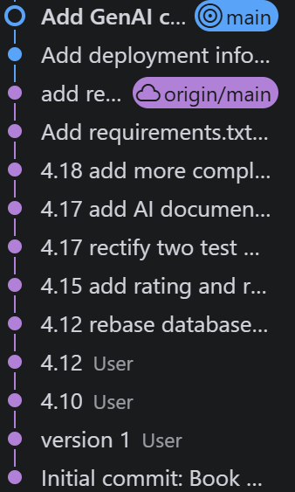




Version Control Practices
Git Core Practices
Commit Timeline
Branch Strategy
Initial Commit:Project environment setup
Standardized commit messages for clarity
Apr. 10-12:Core feature implementation
Regular incremental code pushes to remote
Apr. 15:Added rating & recommendation
Apr. 17-18:Docs, AI declaration & final deployment
Structured branch management workflow
Notes:
We implemented systematic version control using Git, with clear commit messages and regular updates. Our commit history shows the evolution of the project, from initial setup through core functionality implementation, to the addition of rating and recommendation systems, and finally deployment. This approach ensured we could track changes and maintain code quality throughout development.

Slide 5




System Architecture
Architecture Flow Chart
API Endpoints (Core Routes)
Modular routes for handling user requests: Books(CRUD), Auth(Login/Signup), Ratings(Interaction), and Recommendations(Personalization).
Client Application (Input/View)
Data Models (Database Schema)
FastAPI Server (Request Handler)
ORM-defined schemas representing core entities:Book, Author, User, and Rating. Maps directly to PostgreSQL tables for efficient data persistence and retrieval.
Logic Layer (Endpoints & Models)
Recommendation Engine (Algorithms)
Hybrid approach combining: Popularity-based(trending), Author-based(similar writers), and Collaborative Filtering(user similarity) for accurate suggestions.
Notes:
Our system follows a clean, modular architecture. The FastAPI server handles client requests, routing them to appropriate endpoints.
We've organized our code into clear layers: API endpoints, data models, and database interactions. This separation of concerns makes the codebase maintainable and scalable.
The recommendation system is a key component, integrating multiple algorithms—popularity, author-based, and collaborative filtering—to provide personalized book suggestions to users.

Slide 6
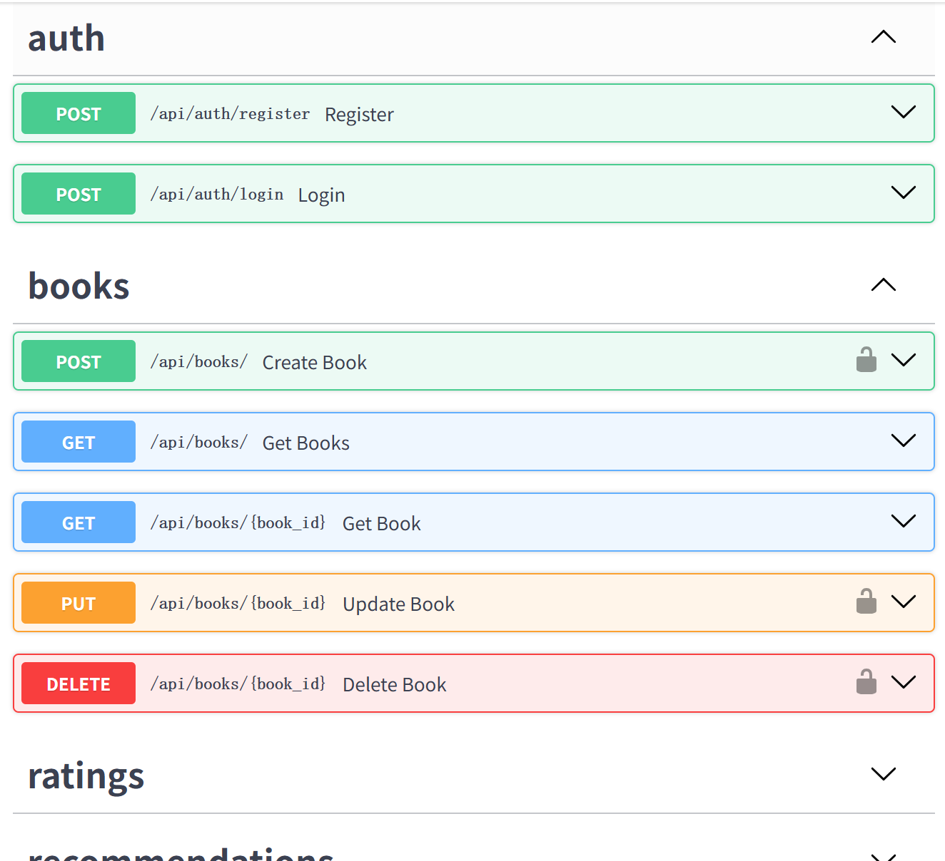




API Documentation
Main Endpoints
Book Management:/api/books/
User Auth:/api/auth/
Rating System:/api/ratings/
Live Deployment URL
https://book-metadata-production.up.railway.app/docs
Notes:
FastAPI automatically generates interactive API documentation using Swagger UI. This documentation provides detailed information about all endpoints, including request parameters, response formats, and authentication requirements.
We've organized our API into logical groups: books, authentication, ratings, and recommendations, making it easy for developers to understand and use the system.

Slide 7





Data Model Design
Database Schema Definition
Entity Relationship Logic
books Table (Core Entity)
Many-to-Many (Books ↔ Authors)
id, title, isbn, publication_year, cover_url, language_code, average_rating, rating_count
A book can have multiple authors, and an author can write multiple books. This is resolved using a junction table in the schema.
authors Table (Creator)
Fields: id (PK), name (full author name)
One-to-Many (Users → Ratings)
A single user can submit multiple ratings, but each individual rating record is associated with exactly one unique user.
users Table (Consumer)
Fields: id (PK), username, email, password_hash
One-to-Many (Books → Ratings)
ratings Table (Interaction)
A book can accumulate many ratings from different users, while each rating refers to one specific book.
Fields: id (PK), user_id (FK), book_id (FK), rating
Notes:
Our data model design focuses on efficiency and relationships. We've created tables for books, authors, users, and ratings, with appropriate relationships between them. The many-to-many relationship between books and authors allows for accurate representation of collaborative works, while the rating system tracks user preferences for recommendation purposes.

Slide 8



Recommendation System
Core Strategies
Hybrid Logic
Core Algorithm
Popularity-based
Priority Hierarchy
Recommends highly-rated items with sufficient user feedback and interaction counts.
Pearson Correlation
Collaborative Filtering > Author-based Strategy > Popularity-based
The primary metric used to calculate the degree of similarity between user rating vectors.
Author-based
Suggests items written by authors that the target user has explicitly liked or interacted with.
Result Deduplication
Removes redundant items from the combined result set to ensure high diversity.
Why Pearson?: Effectively handles variations in individual user rating scales.
Collaborative Filtering: Recommends based on user similarity.
Notes:
Our recommendation system implements three complementary strategies. Popular books recommendation surfaces highly-rated titles with sufficient user feedback. Author-based recommendation suggests books by authors the user has enjoyed. Collaborative filtering finds similar users and recommends books they've liked. We've combined these approaches into a hybrid system that balances personalization and discovery.

Slide 9








Technical Report Highlights
Core Key Points
References & Resources
Tech Stack Rationale for choices
Architecture System design layout
FastAPI Documentation Official guide for API development & async support
Data Model Implementation logic
Algorithms Recommendation system
SQLAlchemy Core Docs ORM & database modeling best practices
GenAI Usage Ethics & declaration
Data Sources Licensing & origin
GoodBooks-10K Dataset Primary source for training data
Notes:
Our technical report provides a comprehensive overview of the project, including the rationale behind our technology stack choices, system architecture design, data model implementation, recommendation system algorithms, GenAI usage declaration, and data source information. We've documented the entire development process, from initial planning through implementation and deployment.

Slide 10



Deployment & Testing
Deployment
Test Results
System Health
DEPLOYMENT PLATFORM
10
100%
NORMAL
Railway
Total Cases
Pass Rate
All Core Functions Running
ACCESSIBLE ENDPOINT
https://book-metadata-production.up.railway.app
COVERED MODULES
• CRUD Operations (Data Layer) • User Authentication Flow • AI Recommendation Logic
PERFORMANCE METRICS
• API Latency < 200ms • Zero Critical Errors • Stable DB Connection
● Successfully Deployed
Notes:
We've successfully deployed our application to the Railway platform, making it accessible through the provided URL. Our testing strategy included comprehensive test cases covering CRUD operations, authentication flows, and recommendation functionality. All 10 test cases passed successfully, demonstrating the reliability of our system.

Slide 11




Deliverables
GitHub Repo
API Docs
Technical Report
github.com/zhu0117/Book-Metadata.git
/book-metadata-production.up.railway.app/docs
File: TECHNICAL_REPORT.md Detailed analysis & methodology
Presentation Slides
Deployed Web Application
File: PRESENTATION_SLIDES.md (PDF/PPTX export available)
URL: book-metadata-production.up.railway.app Fully functional & responsive
Project Status: Completed
All deliverables are finalized, fully documented, and accessible for review.
Notes:
Our project deliverables include the GitHub code repository, interactive API documentation, technical report, and the deployed application. All components are complete and accessible, providing a comprehensive solution for book metadata management and recommendation.

Slide 12





Conclusion
Project Summary
Future Outlook
Successfully implemented a comprehensive book metadata management and intelligent recommendation system.
The system architecture has excellent scalability to accommodate increasing data volume.
Adopted a clean, modular architecture that ensures high code maintainability and quality.
Provides a solid and robust foundation for the development of future advanced features.
Completed full-cycle documentation, rigorous testing, and stable production deployment.
Demonstrates full capabilities in designing and building production-ready RESTful APIs.
Notes:
In conclusion, we've successfully implemented a comprehensive book metadata management and recommendation system. The project features a clean, modular architecture, secure authentication, and intelligent recommendation algorithms. With complete documentation and successful deployment, the system provides a solid foundation for future enhancements and demonstrates our ability to build production-ready API systems.

Slide 13

Thank you for your attention!
Notes:
Thank you for your attention. I'm now open to any questions you may have about our Book Metadata and Recommendation API project.

